Slide 1
Appendix One
Pumping Lemma for RL

Slide 2
Standard Representations of Regular Languages
Regular Languages
DFAs
Regular
Grammars
NFAs
Regular
Expressions

Slide 3

When we say:
We are given
a Regular Language
We mean:
Language is in a standard
representation

Slide 4
What are the differences among NFA/DFA, regular expression and regular grammar?
NFA/DFA accepts languages
Regular expresses operate languages
Grammar generates language

Slide 5
Elementary Questions about
Regular Languages

Slide 6


Membership Question
Question:
Given regular language
and string
how can we check if ?
Answer:
Take the DFA that accepts
and check if is accepted

Slide 7


DFA
DFA

Slide 8
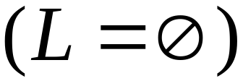
Question:
Given regular language
how can we check
if is empty: ?
Answer:
Take the DFA that accepts
Check if there is any path from
the initial state to a final state

Slide 9


DFA
DFA

Slide 10
Question:
Given regular language
how can we check
if is finite?
Answer:
Take the DFA that accepts
Check if there is a walk with cycle
from the initial state to a final state

Slide 11
DFA
is infinite
DFA
is finite

Slide 12


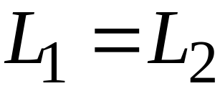
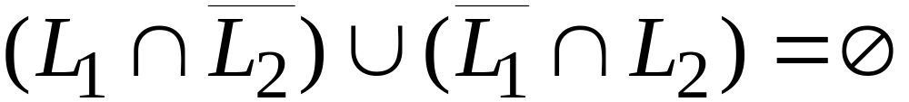
Question:
Given regular languages and
how can we check if ?
Answer:
Find if

Slide 13
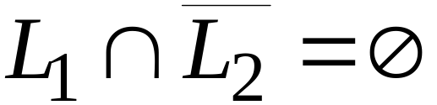
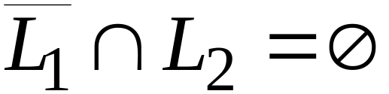


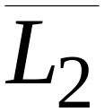
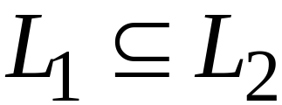
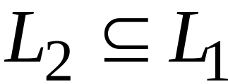
and

Slide 14

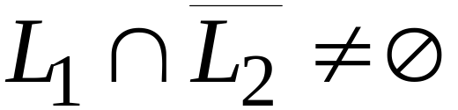
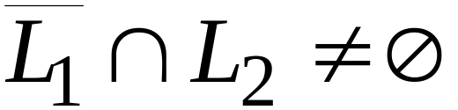
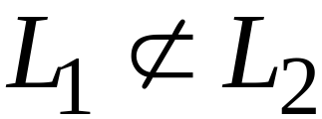
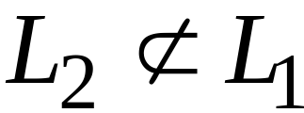
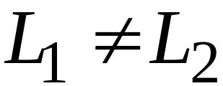
or

Slide 15
Non-regular languages

Slide 16
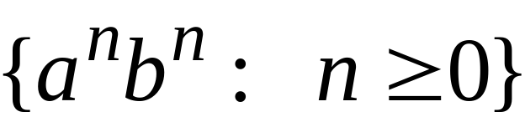
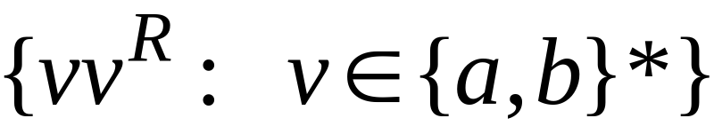


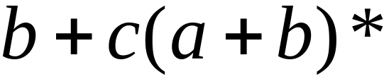

Non-regular languages
Regular languages
Finite languages are regular

Slide 17

How can we prove that a language
is not regular?
Prove that there is no DFA that accepts
Problem: this is not easy to prove
Solution: the Pumping Lemma !!!

Slide 18

The Pigeonhole Principle

Slide 19


pigeons
pigeonholes

Slide 20
A pigeonhole must
contain at least two pigeons

Slide 21



pigeons
...........
pigeonholes
...........

Slide 22
The Pigeonhole Principle
pigeons
pigeonholes
There is a pigeonhole
with at least 2 pigeons
...........

Slide 23
Ex1
Show that if any five numbers from 1 to 8 are chosen, then two of them will add up to 9.
Solution: {1,8}，{2,7}，{3,6}，{4,5}

Slide 24
Ex 2
Show that if any 11 numbers are chosen from the set {1,2,…,20}, then one of them will be a multiple of another.
Solution:
{1,2,…,20}={2^{k}m|k could be any positive integer including 0, m=some odd number}
2^{k1}m, 2^{k2}m

Slide 25
Ex 3
Consider the region shown in the figure. It is bounded by a regular hexagon whose sides are of length 1 unit. Show that if any seven points are chosen in this region, then two of them must be no farther apart than 1 unit.

Slide 26
Ex 4
n+1 integers are chosen from consecutive integer set of 1 to 3n. Show that there must be two integers such that the difference of them is not larger than 2.
Solution: {1, 2, 3}, {4, 5, 6}, …, {3n-2, 3n-1, 3n}

Slide 27

Ex 5
Any 52 positive integers are chosen. There must exist two integers in it such that the sum of them or the difference of them is a multiple of 100.

Slide 28
The Pigeonhole Principle and
DFAs

Slide 29




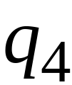


DFA with states

Slide 30
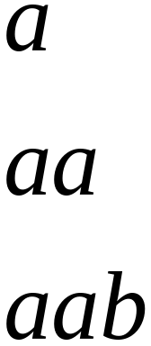
In walks of strings:
no state
is repeated

Slide 31
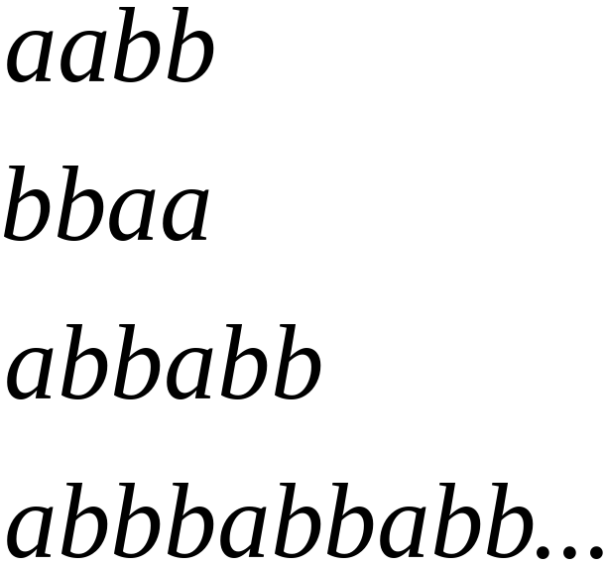
In walks of strings:
a state
is repeated

Slide 32
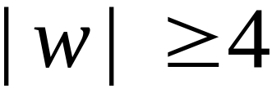
If string has length :
Then the transitions of string
are more than the states of the DFA
Thus, a state must be repeated

Slide 33



In general, for any DFA:
String has length number of states
A state must be repeated in the walk of
walk of
......
......
Repeated state

Slide 34
In other words for a string :
transitions are pigeons
states are pigeonholes
walk of
......
......
Repeated state

Slide 35
The Pumping Lemma

Slide 36






The Pumping Lemma:
Given a infinite regular language
there exists an integer
for any string with length
we can write
with and
such that:

Slide 37
Applications of the Pumping Lemma

Slide 38

Theorem:
The language
is not regular.
Proof:
Use the Pumping Lemma

Slide 39
Assume for contradiction
that is a regular language
Since is infinite
we can apply the Pumping Lemma

Slide 40
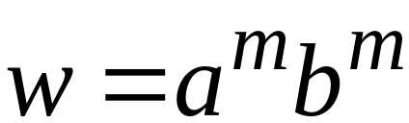
Let be the integer in the Pumping Lemma
Pick a string such that:
length
We pick

Slide 41
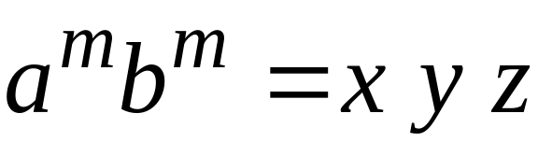

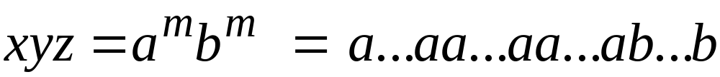



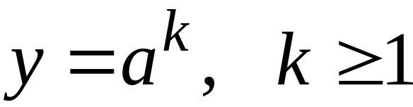
Write:
From the Pumping Lemma
it must be that length
Thus:

Slide 42
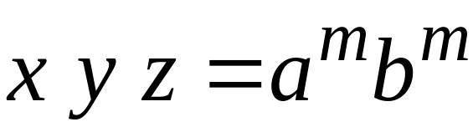

From the Pumping Lemma:
Thus:

Slide 43

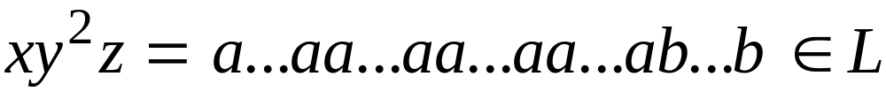
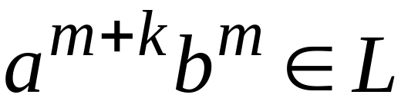
From the Pumping Lemma:
Thus:

Slide 44
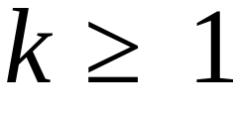
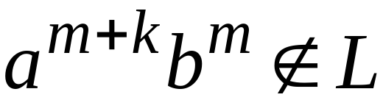
BUT:
CONTRADICTION!!!

Slide 45
Therefore:
Our assumption that is a regular language is not true.
Conclusion:
is not a regular language.

Slide 46
Non-regular languages
Regular languages

Slide 47
Understanding pumping lemma more

Slide 48

Take an infinite regular language
There exists a DFA that accepts
states

Slide 49
Take string with
There is a walk with label :
.........
walk

Slide 50
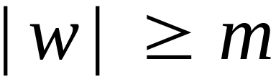
If string has length
(number
of states
of DFA)
then, from the pigeonhole principle:
a state is repeated in the walk
......
......
walk

Slide 51
Let be the first state repeated in the
walk of
......
......
walk

Slide 52
Write
......
......

Slide 53
Observations:
length
number
of states
of DFA
length
......
......

Slide 54

Observation:
The string
is accepted
......
......

Slide 55

Observation:
The string
is accepted
......
......

Slide 56

Observation:
The string
is accepted
......
......

Slide 57
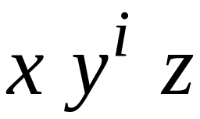
In General:
The string
is accepted
......
......

Slide 58
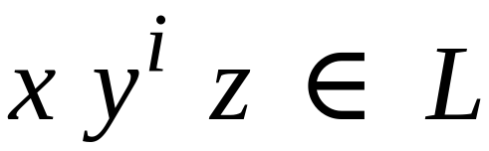
In General:
Language accepted by the DFA
......
......

Slide 59
In other words, we described:
The Pumping Lemma !!!

Slide 60
End

